Slide 1
Les Migrations en Méditerranée : Enjeux et Politique Européennes
Jad EL CHAMMAS
Constantin BAUDELET de LIVOIS

Slide 2
Définitions Essentielles
Réfugié
Migrant
Asile Politique
Personne fuyant un danger, ne pouvant bénéficier de protection de son pays.
Terme plus large, personnes quittant leur pays pour raisons diverses.
Protection demandée en raison de menaces politiques.

Slide 3
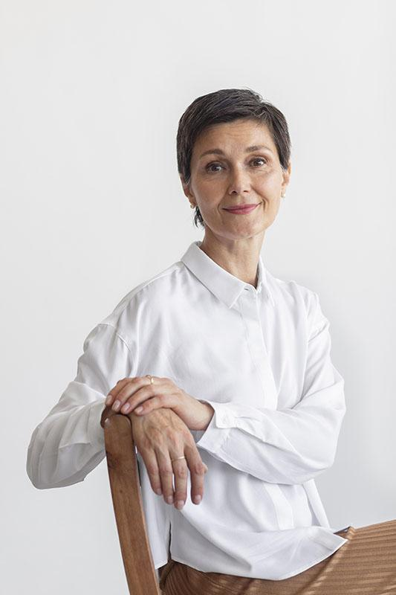
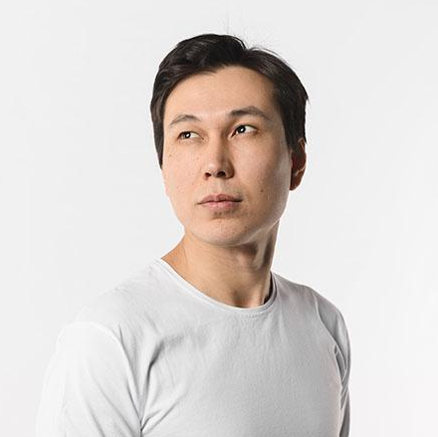
SCHEDULE - SESSION TALKS
DAY 1 | DAY 2 | DAY 3
January 10, 20XX | January 11, 20XX | January 12, 20XX
ELLEN DOE
BUSINESS MANAGEMENT
CEO & founder
Jupiter is a gas giant and the biggest planet in the Solar System. It's the fourth-brightest object in the night sky. It was named after a Roman god
9:00 - 11:00
Venus Hotel
DANIEL JAM
BUILD YOUR OWN BUSINESS
Acc. manager
Mercury is the closest planet to the Sun and the smallest in the entire Solar System. Its name has nothing to do with the liquid metal
11:15 - 15:15
Venus Hotel

Slide 4
01
ABOUT THE SPEAKERS
You could enter a subtitle here if you need it

Slide 5
SPEAKER 01
ELLEN DOE
CEO & founder
Jupiter is a gas giant and the biggest planet in the Solar System. It's the fourth-brightest object in the night sky. It was named after the Roman god of the skies and lightning
Saturn is a gas giant and has several rings. It's composed mostly of hydrogen and helium. It was named after the Roman god of wealth and agriculture
You can replace the image. Just right-click on it and select “Replace image”

Slide 6
—SOMEONE FAMOUS
“This is a quote. Words full of wisdom that someone important said and that can inspire the reader.”

Slide 7

OUR HISTORY
Jupiter is a gas giant and the biggest planet in the Solar System. It's the fourth-brightest object in the night sky. It was named after the Roman god of the skies and lightning
Saturn is a gas giant and has several rings. It's composed mostly of hydrogen and helium. This planet was named after the Roman god of wealth and agriculture
Earth is the third planet from the Sun and the only one that harbors life in the Solar System. This is where we all live

Slide 8
TIMELINE
VENUS
SATURN
JUPITER
MERCURY
Venus is the second-brightest natural object in the night sky
Saturn was named after the Roman god of wealth and agriculture
Jupiter is a gas giant and the biggest planet in the Solar System
Mercury is the closest planet to the Sun and the smallest one

Slide 9
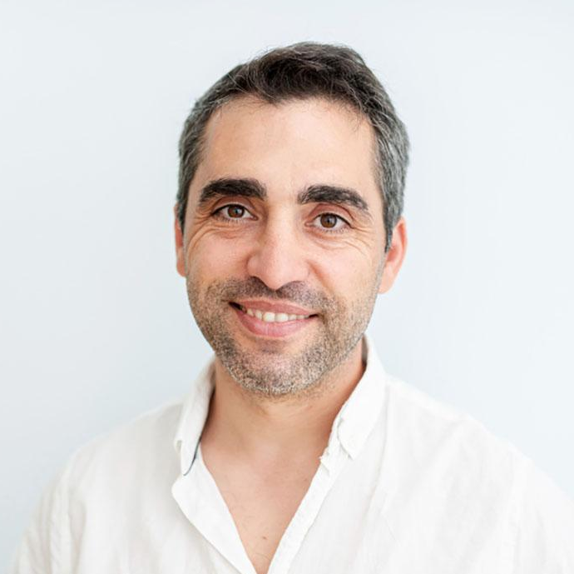
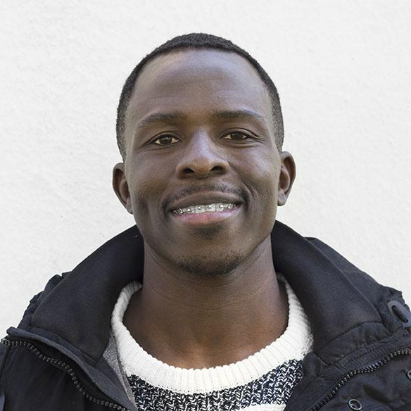
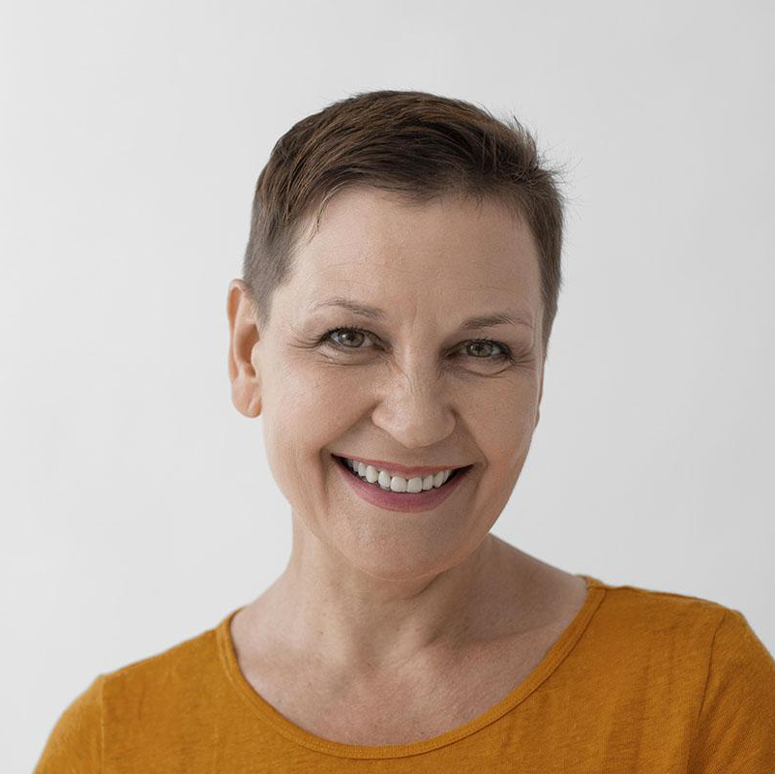

OUR TEAM OF EXPERTS
TIMMY JIMMY
JULIAN LYMAN
Despite being red, Mars is actually a cold place
Earth is the beautiful planet where we all live
TRACEY BOWER
LILY REID
Saturn is the second-largest planet in the Solar System
Neptune is the fourth-largest planet in the Solar System

Slide 10
02
OUR IDEA
You could enter a subtitle here if you need it

Slide 11
OUR BIG IDEA #1
MERCURY
JUPITER
It’s the closest planet to the Sun and the smallest one
Jupiter is the biggest planet in the Solar System
VENUS
SATURN
Venus is the second-brightest natural object in the night sky
Saturn is composed mostly of hydrogen and helium
NEPTUNE
MARS
Neptune is the farthest planet from the Sun
Despite being red, Mars is actually a cold place

Slide 12
OUR BIG IDEA #2
5/15
10/15
MERCURY
MARS
It’s the closest planet to the Sun
Mars is full of iron oxide dust
25%
SATURN
75%
NEPTUNE
Saturn is a gas giant and has rings
It’s the farthest planet from the Sun

Slide 13
OUR BIG IDEA #3
IDEA #3
STEP 1
STEP 2
STEP 3
VENUS
MARS
JUPITER
EARTH
SATURN
Venus is a very hot place
Mars is a very cold place
Jupiter is a huge gas giant
Earth is the planet with life
Saturn is the ringed planet

Slide 14
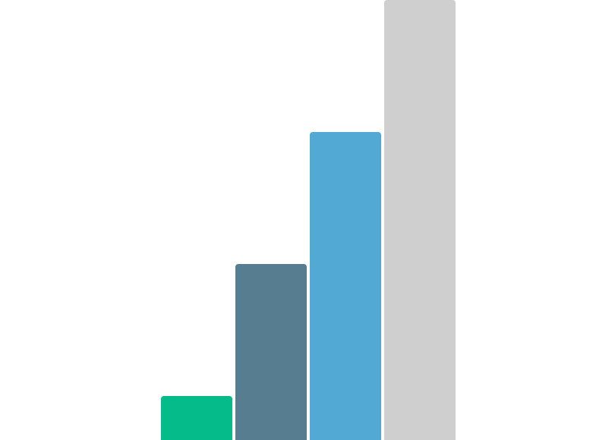
CHARTS
100
700
MERCURY
JUPITER
It’s the closest planet to the Sun
Jupiter is the biggest planet
400
1,000
MARS
NEPTUNE
Mars is actually a cold place
Neptune is the outermost planet
Follow the link in the graph to modify its data and then paste the new one here. For more info, click here

Slide 15
24,000
33,300
38,600
Jupiter is a gas giant and the biggest planet
Saturn is a gas giant and has several rings
Neptune is the farthest planet from the Sun

Slide 16
OUR PRICING
LEVEL 1 | LEVEL 2 | LEVEL 3
Mercury is the closest planet to the Sun Mercury is the smallest planet of them all | Venus is the second planet from the Sun Venus is hot, even hotter than Mercury | Despite being red, Mars is a cold place Mars is full of iron oxide dust, making it reddish
$50 | $100 | $125

Slide 17
WHAT’S NEXT?
04
Jupiter is the biggest planet of them all
NOW
03
Saturn is a gas giant and has several rings
Neptune is the fourth-largest planet in the Solar System
02
Despite being red, Mars is a cold place
01
Venus is the second planet from the Sun
THEN

Slide 18
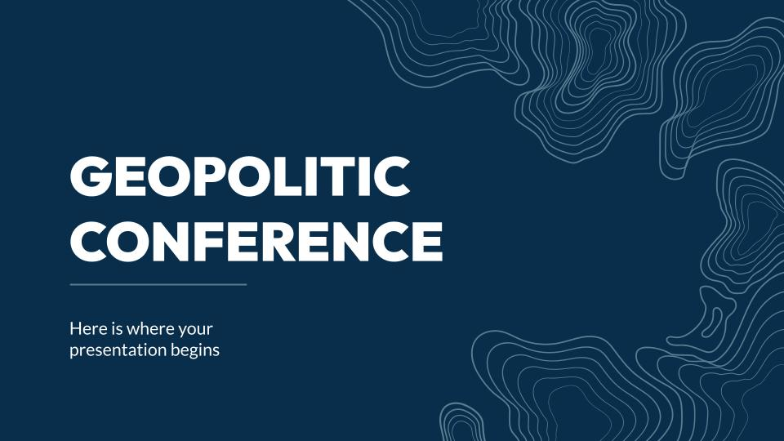
MOCKUP
You can replace the image on the screen with your own work. Just right-click on it and select “Replace image”

Slide 19
YOU HAVE SOME TIPS HERE
DO YOU HAVE ANY QUESTIONS?
You can write the tips for your audience here:
Neptune the farthest planet from the Sun
Despite being red, Mars is a cold place
Saturn is composed of hydrogen and helium
Jupiter is the biggest planet of them all
Mercury is the closest planet to the Sun
Don’t miss the chance to ask something important now

Slide 20
03
TO SUM UP
You can enter a subtitle here if you need it

Slide 21
CONFERENCE HIGHLIGHTS
MERCURY
JUPITER
It’s the closest planet to the Sun and the smallest one
Jupiter is the biggest planet in the Solar System
VENUS
SATURN
Venus is the second-brightest natural object in the night sky
Saturn is composed mostly of hydrogen and helium
NEPTUNE
Neptune is the farthest planet from the Sun

Slide 22
OUR FUTURE CONFERENCES
JUPITER
M | T | W | T | F | S | S
1 | 2 | 3 | 4 | 5 | 6 | 7
8 | 9 | 10 | 11 | 12 | 13 | 14
15 | 16 | 17 | 18 | 19 | 20 | 21
22 | 23 | 24 | 25 | 26 | 27 | 28
29 | 30 | 31
Jupiter is a gas giant and the biggest planet
MARS
Despite being red, Mars is a cold place
NEPTUNE
It’s the farthest planet from the Sun

Slide 23
THANKS TO ALL OUR SPONSORS
Jupiter is a gas giant and the biggest planet in the Solar System. It's the fourth-brightest object in the night sky. It was named after the Roman god of the skies and lightning

Slide 24
THANKS!
Do you have any questions?
youremail@freepik.com
+91 620 421 838
yourwebsite.com
Please keep this slide for attribution

Slide 25
ALTERNATIVE RESOURCES
Here’s an assortment of alternative resources within the same style of this template
VECTORS
Circular topographic lines on blue background
Free vector topographic map background

Slide 26
RESOURCES
Did you like the resources? Get them for free at our other websites.
VECTORS
Topographic lines background
PHOTOS
Beautiful middle aged woman portrait
Portrait young male
Black woman with blank shirt full shot
People meeting at community center
Medium shot smiley man posing
Close up smiley woman posing
Portrait of afro american man
Female standing with arms crossed

Slide 27
Instructions for use
If you have a free account, in order to use this template, you must credit Slidesgo by keeping the Thanks slide. Please refer to the next slide to read the instructions for premium users.
As a Free user, you are allowed to:
Modify this template.
Use it for both personal and commercial projects.
You are not allowed to:
Sublicense, sell or rent any of Slidesgo Content (or a modified version of Slidesgo Content).
Distribute Slidesgo Content unless it has been expressly authorized by Slidesgo.
Include Slidesgo Content in an online or offline database or file.
Offer Slidesgo templates (or modified versions of Slidesgo templates) for download.
Acquire the copyright of Slidesgo Content.
For more information about editing slides, please read our FAQs or visit our blog:
https://slidesgo.com/faqs and https://slidesgo.com/slidesgo-school

Slide 28
Instructions for use (premium users)
As a Premium user, you can use this template without attributing Slidesgo or keeping the Thanks slide.
You are allowed to:
Modify this template.
Use it for both personal and commercial purposes.
Hide or delete the “Thanks” slide and the mention to Slidesgo in the credits.
Share this template in an editable format with people who are not part of your team.
You are not allowed to:
Sublicense, sell or rent this Slidesgo Template (or a modified version of this Slidesgo Template).
Distribute this Slidesgo Template (or a modified version of this Slidesgo Template) or include it in a database or in any other product or service that offers downloadable images, icons or presentations that may be subject to distribution or resale.
Use any of the elements that are part of this Slidesgo Template in an isolated and separated way from this Template.
Register any of the elements that are part of this template as a trademark or logo, or register it as a work in an intellectual property registry or similar.
For more information about editing slides, please read our FAQs or visit our blog:
https://slidesgo.com/faqs and https://slidesgo.com/slidesgo-school

Slide 29
Fonts & colors used
This presentation has been made using the following fonts:
Outfit
(https://fonts.google.com/specimen/Outfit)
Lato
(https://fonts.google.com/specimen/Lato)
#092e4b
#ffffff
#52a9d4
#06bb8a
#577d90
#cfcfcf
#979797

Slide 30





Storyset
Create your Story with our illustrated concepts. Choose the style you like the most, edit its colors, pick the background and layers you want to show and bring them to life with the animator panel! It will boost your presentation. Check out how it works.
Pana
Amico
Bro
Rafiki
Cuate

Slide 31
Use our editable graphic resources...
You can easily resize these resources without losing quality. To change the color, just ungroup the resource and click on the object you want to change. Then, click on the paint bucket and select the color you want. Group the resource again when you’re done. You can also look for more infographics on Slidesgo.

Slide 34
JANUARY
FEBRUARY
MARCH
APRIL
MAY
JUNE
PHASE 1
Task 1
Task 2
PHASE 2
Task 1
Task 2
JANUARY
FEBRUARY
MARCH
APRIL
PHASE 1
Task 1
Task 2

Slide 37
...and our sets of editable icons
You can resize these icons without losing quality.
You can change the stroke and fill color; just select the icon and click on the paint bucket/pen.
In Google Slides, you can also use Flaticon’s extension, allowing you to customize and add even more icons.

Slide 38
Educational Icons
Medical Icons

Slide 39
Business Icons
Teamwork Icons

Slide 40
Help & Support Icons
Avatar Icons

Slide 41
Creative Process Icons
Performing Arts Icons

Slide 42
Nature Icons

Slide 43
SEO & Marketing Icons

Slide 44


